Slide 1


School of Basic and Applied Sciences
Course Code: BBS01T1002 Course Name: Semiconductor Physics
Elemental semiconductor
&
Compound semiconductor
Name of the Faculty: Dr. Prabhakar Singh Program Name: B.Tech

Slide 2
Topics to be covered
Basics of semiconductor
Classification of semiconductor
Elemental semiconductor
Compound semiconductor
Practice questions
References

Slide 3
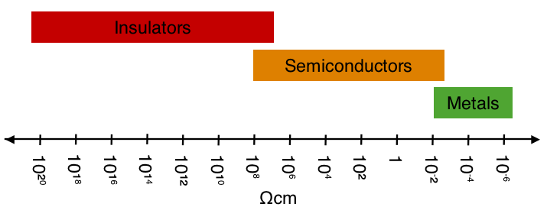
Prerequisite/Recapitulations
--
Semiconducting materials:
Semiconductors are the materials which have electrical conductivities lying between those of good conductors and insulators. The resistivity of semiconductors varies from 10⁻³ to 10⁺⁸ ohm-cm as compared to the values ranging from 10⁻² to 10⁻⁷ ohm-cm for conductors and from 10⁷ to 10²⁰ ohm-cm for insulators.
Another important characteristic of the semiconductors is that they have small band gap. The band gap of semiconductors varies from 0.2 to 2.5 eV which is quite small as compared to that of insulators. The band gap of a typical insulator such as diamond is about 6 eV.

Slide 4
Objectives
After the completion of the lecture you will be able to:
To understand the formation of covalent bonds in semiconductor
To explain the elemental semiconductor materials
To explain the compound semiconductor semiconductor materials
To understand the semiconductor materials that are
suitable for electronic devices
To study the properties of materials for electronic
devices

Slide 5
Introduction
Classification of Semiconductors:
There are different ways of classifying semiconductors depending on the property being measured. One classification that is fairly straight forward is
Elemental semiconductors
Compound semiconductor

Slide 6
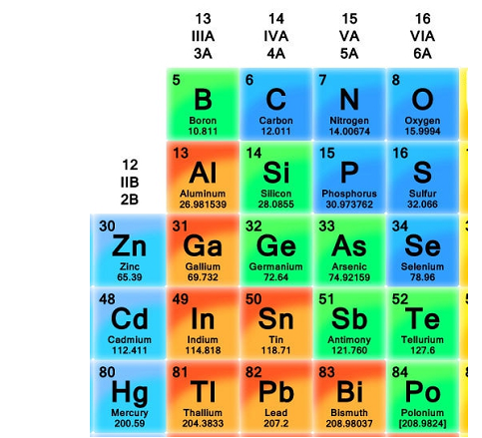
Elemental and compound semiconductor
Out of the elemental semiconductors Si and Ge are the most common.
Moreover, there are different type of compound semiconductors - II-VI and III-V are the most common and these can be understood by looking at the portion of the periodic table, shown in this figure.
Figure : Portion of the periodic table showing the group IV elements and their common dopants.

Slide 7

Elemental Semiconductor
Silicon (Si)
Germanium (Ge)
These are important group IV elemental semiconductors
All of them have diamond crystal structure
Boron (B)
It belongs to group III
It has rhombohedral crystal structure
Phosphorus (P)
It belongs to group V
Sulphur (S)
Selenium (Se)
Tellurium (Te)
These belong to group VI

Slide 8
Elemental and Compound semiconductor
Elemental semiconductors (Si and Ge) belong to group IV A of the periodic table. C which is on top of the group is an insulator (diamond) with energy band gap of 5.5 eV while Sn and Pb are metals.
Compound semiconductors can be formed by combining elements of groups IIIA and VA. Examples include GaAs, GaP, GaN, InSb. AlN is also a III-V but its band gap is around 6.2 eV making it an insulator. Similarly II-VI compound semiconductors can be formed, examples include ZnO, ZnS, CdSe, CdTe.

Slide 9
Elemental Semiconductor
limitations of silicon:
Its energy band-gap is 1.12eV
It is an indirect semiconductor that limits the application in optoelectronics
It has relatively low carrier mobility as compared to other semiconductor such as gallium arsenide GaAs

Slide 10
Compound Semiconductors
They are usually formed from
o III-V group
o II-VI
o IV-VI
III-V group semiconductors are GaAs, GaP, GaN, AlAs, InSb, InAs, InP etc
In general, these are crystallized materials

Slide 11
Compound Semiconductors
GaAs, InAs, InP, InSb have direct energy band-gaps and high carrier mobilities
Common applications of these semiconductors:
used to design a variety of optoelectronic devices for
detection and generation of electromagnetic radiation
in high-speed electronic devices
The energy band-gaps of these compounds are useful for
optoelectronic applications
The energy bandgap ranges from 0.17eV for InSb to 3.44eV for GaN

Slide 12
Compound Semiconductors
II-VI compound semiconductor:
II-VI compound semiconductor such as Zn and compounds with oxygen O, S, Se
These cover a wide range of electronic and optical properties due to the wide variations in their energy bandgap
These are typically n-type as grown, except ZnTe, which is p- type
All the II-VI compound semiconductors have direct energy
bandgaps

Slide 13
Compound Semiconductors
IV-VI compound semiconductor
PbS, PbSe, and PbTe
Characterized by narrow energy gaps, high carrier mobilities, and high dielectric constants
The unique feature of the direct energy gap in these compounds is that its energy band-gap increases with increasing temperature, which means the energy gap has a positive temperature coefficient
Main applications of these compounds are in light emitting
devices and detectors in the infrared spectral region

Slide 14
Practice Questions
Define the formation of covalent bonds in intrinsic semiconductor.
2. Explain elemental semiconductor with examples.
3. Explain compound semiconducting materials with the examples of a combinations of Group III and Group V elements or Group II and Group VI elements.

Slide 15
References:
1. J. Singh , Semiconductor optoelectronics, Physics and Technology, Mc-Graw –Hill Inc. 1995.
2. S.M. Sze, Semiconductor Devices: Physics and Technology, Wiley 2008.
3. Pillai S O, Solid State Physics,( 2010), sixth edition, New Age International (P) Ltd. ISBN-9788122427264.
4. M.N. Avadhanulu and P.G. Kshirsagar, A Text book of Engineering Physics-, 10th
revised Ed, S. Chand & Company Ltd, New Delhi

